Slide 1
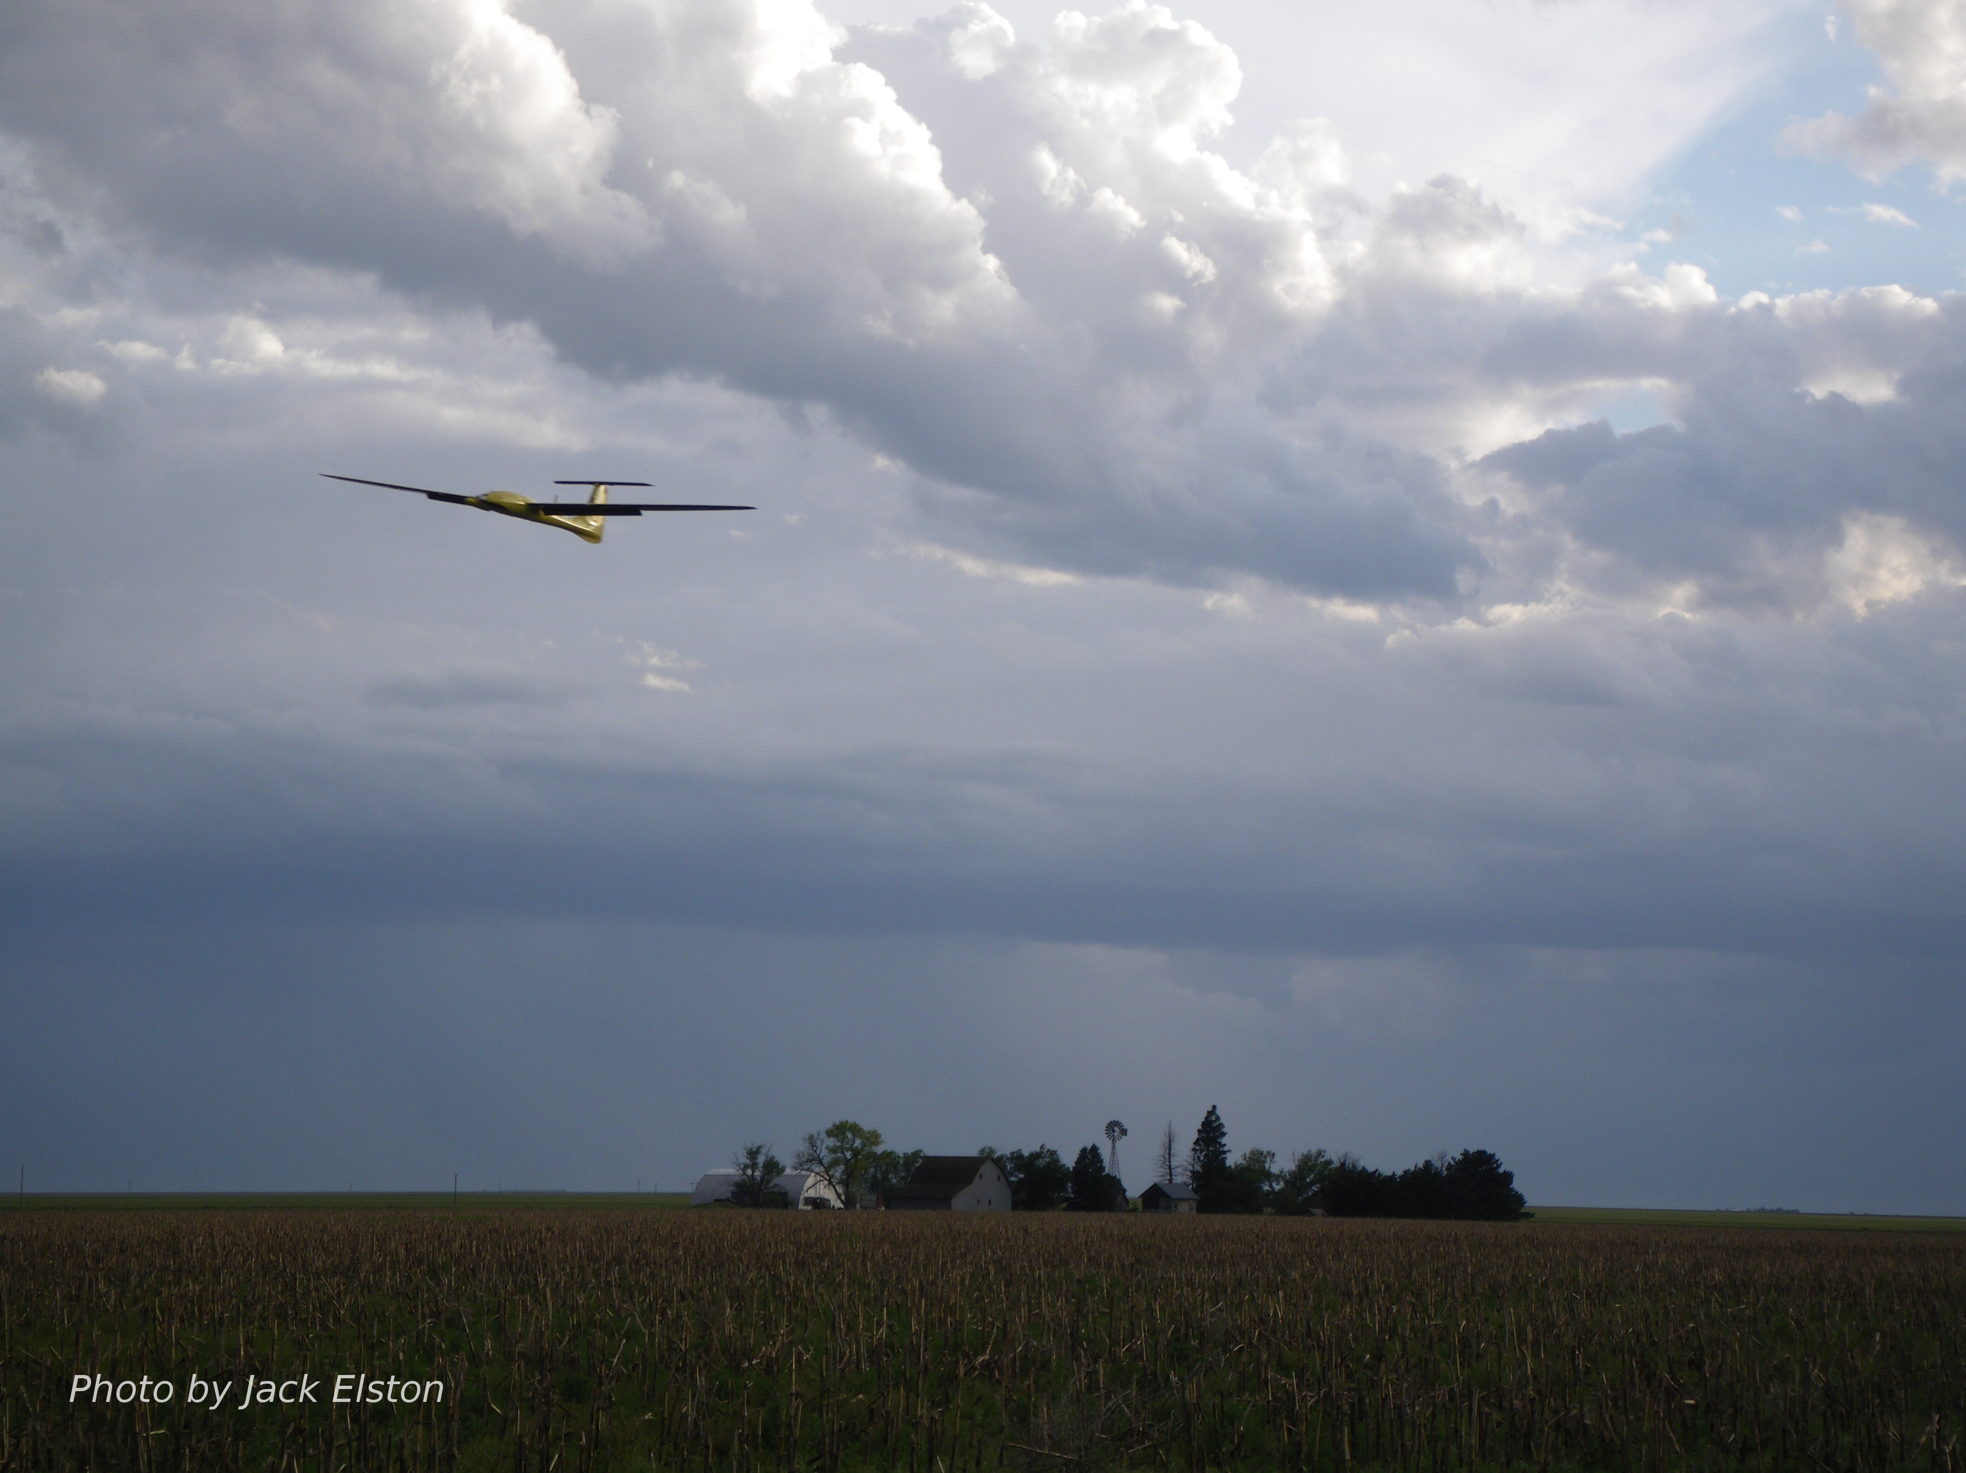
Chapter 1
Introduction

Slide 2
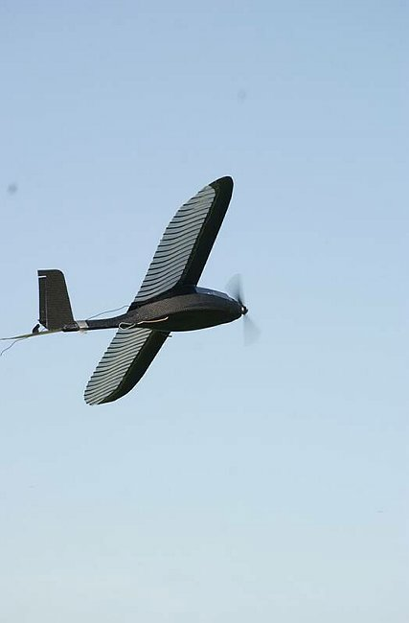
Potential Applications for Small UAVs
Civil and Commercial:
Monitoring environment − meteorology, pollution, mapping, mineral exploration
Monitoring disaster areas − forest fires, avalanches, nuclear contamination
Communications relays − news broadcasts, disaster relief, sports events
Law enforcement − road traffic, border patrol, drug control
Precision agriculture − crop monitoring
Military:
Special Operations: Situational awareness
Intelligence, surveillance, and reconnaissance
Communication node
Battle damage assessment
Homeland Security:
Border patrol
Surveillance
Rural/urban search and rescue
New related area:
Air mobility of humans, goods, services

Slide 3
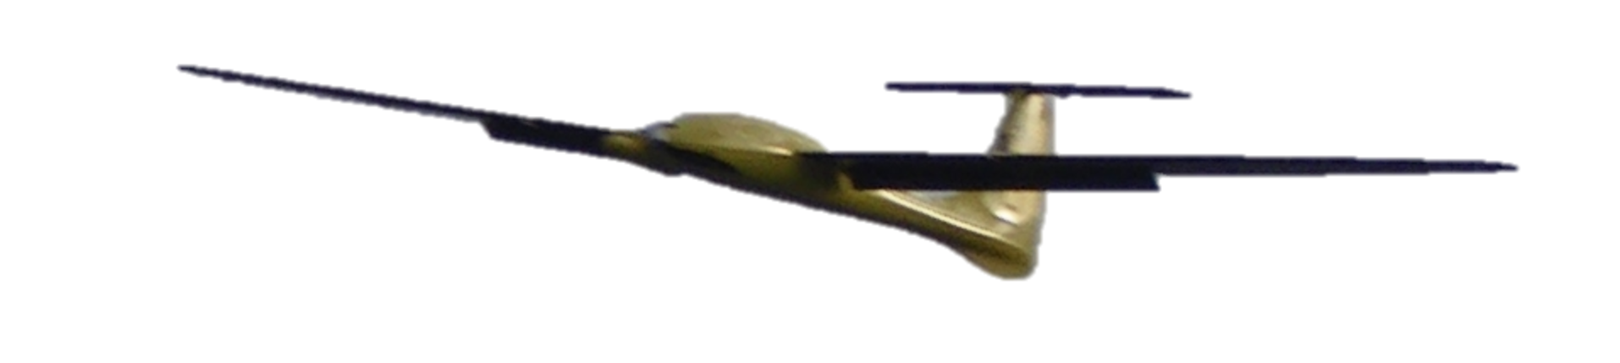
Control Design Process
Physical System
The real thing
1st principles
Detailed model
ODE’s, nonlinear, high order
Includes everything that is feasible to model
Hi-fi representation of real physical system behavior
Too complex for control design
Simulation
Model
ODE’s, linear, low order
May only consider a portion of dynamic behavior
Simpler to understand
Captures dominant behavior
Design
Model
Control
Design

Slide 4
Simulation Model

Slide 5
Simulation Model

Slide 6
Control Design Process
Physical System
The real thing
1st principles
Detailed model
ODE’s, nonlinear, high order
Includes everything that is feasible to model
Hi-fi representation of real physical system behavior
Too complex for control design
Simulation
Model
Design
Model
ODE’s, linear, low order
May only consider a portion of dynamic behavior
Simpler to understand
Captures dominant behavior
Control
Design

Slide 7
Design Model
Course from aileron transfer function:

Slide 8

Control Design
Design model

Slide 9
Control Design Process
Physical System
The real thing
1st principles
Detailed model
ODE’s, nonlinear, high order
Includes everything that is feasible to model
Hi-fi representation of real physical system behavior
Too complex for control design
Simulation
Model
Design
Model
ODE’s, linear, low order
May only consider a portion of dynamic behavior
Simpler to understand
Captures dominant behavior
Control
Design

Slide 10
Control Design Process
Design
Model
Step 1:
Linear, low-order model
Control design and system model implemented in software
Control
Design

Slide 11
Control Design Process
Simulation
Model
Step 2:
Detailed system model
Control design and system model implemented in software
Control
Design

Slide 12
Control Design Process
Physical System
hardware
Step 3:
Real system hardware
Control design implemented in software
Control
Design
software

Slide 13
Architecture

Slide 14
Architecture w/ Camera

Slide 15
Course Project Ideas
Implement autopilot components on hardware using ROSflight, PixHawk, or another autopilot
Develop learning modules for the African Drone and Data Academy in Malawi (e.g., Jupyter notebooks)
Integrate our course simulator into the AirSim simulator (https://github.com/microsoft/AirSim)
Extend existing autopilot components to do something in a different way (e.g., perform path following using MPC)
Extend existing autopilot to do something new (e.g., use machine vision to land on a target)
Something of your own creation that builds on the concepts of this course

